Slide 1
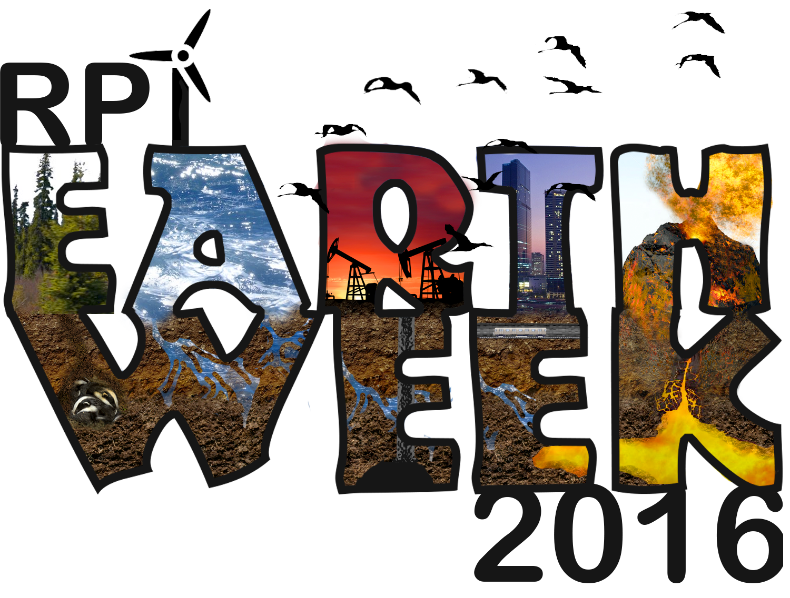
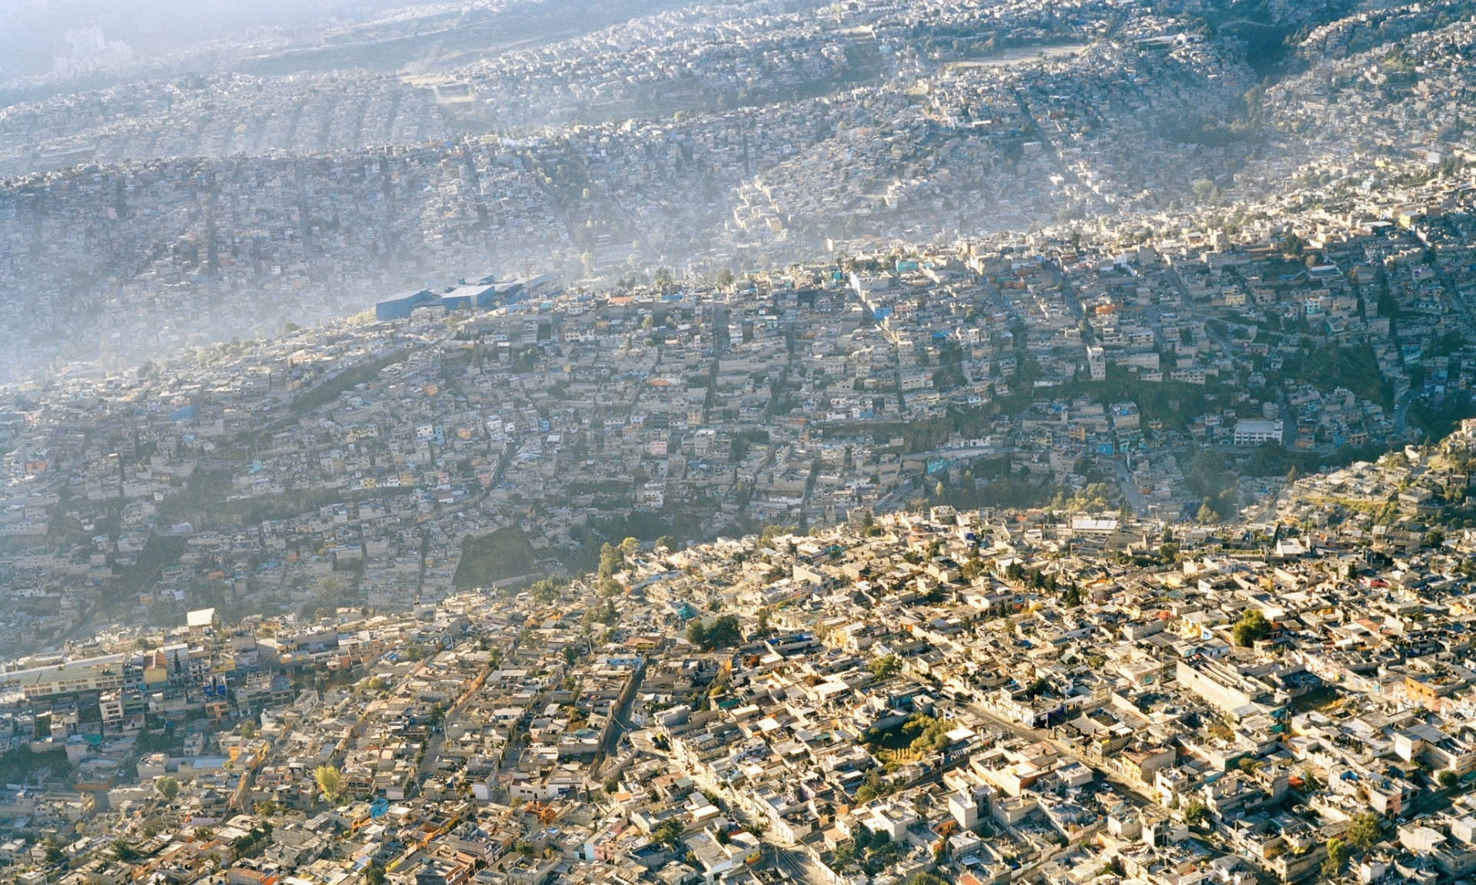
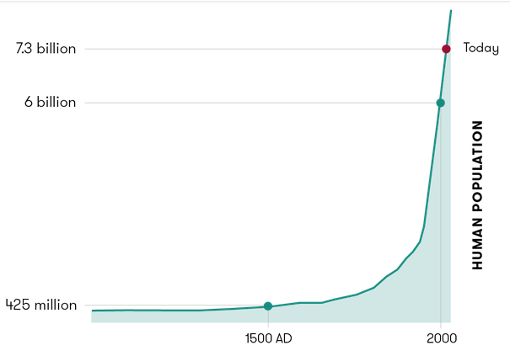
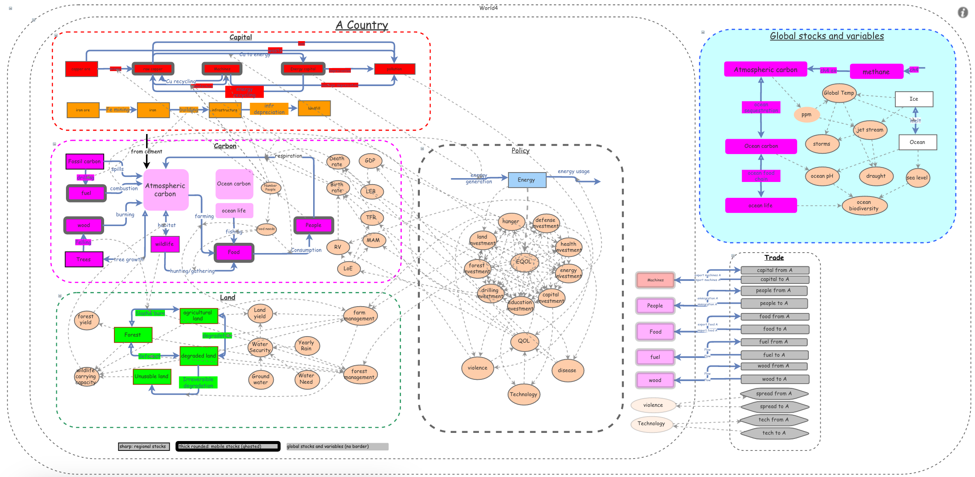
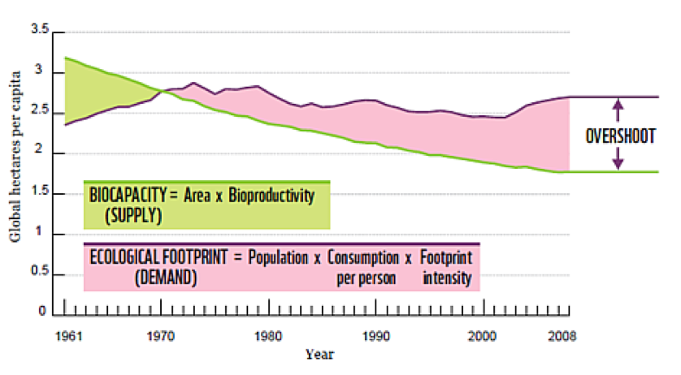
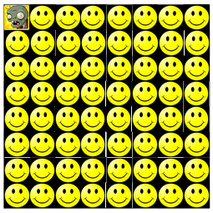
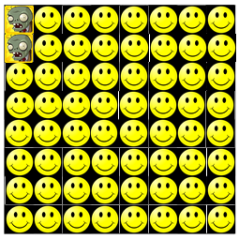
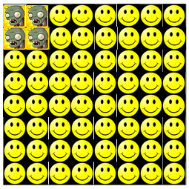
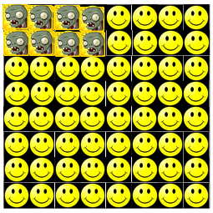
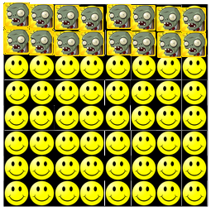
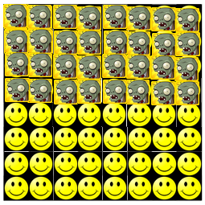
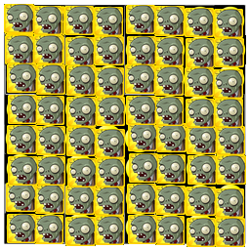
BIOL 4961 Human Population
In this course, we study the dynamics of the global human ecosystem – the population, the carrying capacity, and the ecological impact of our species on this planet. Humanity has shot up in population over the last 100 years, leading to a global crisis in pollution, mass extinctions, deforestation, and global warming. Where will we end up? Will we extinguish ourselves along with the polar bears and the tree frogs, or will we dig into this very difficult problem, understand it well, and find our way out of this mess. Isn’t it about time we started talking about overpopulation?
Ecological footprint: What is the total amount of Earth’s surface dedicated to keeping YOU alive – your food, your energy, your waste. That is your ecological foot print.
insightmaker.com
Systems dynamics: Where does our food come from? Where does our carbon go when we breathe it out? How do our decisions affect our quality of life? A systems dynamics model attempts to capture these qualities and quantities so that we may understand the big picture.
Exponential growth
Exponential growth starts slowly, but leads to very rapid changes that can be hard to react to. For example, there is one zombie on day one and every day each zombie can infect one human. For the first few days the problem looks manageable. On day 6 half the humans have become zombies, but there is still a healthy human population. On day 7 all the humans are zombies!!
Day 1
Day 2
Day 3
Day 4
Day 5
Day 6
Day 7
Luke Buscher , Reilly Cooper , Christopher Hartline , Evan Homone , Ikram Hussain, Vijay Jani , Thomas Jordan , Rachel Kaufman , Catherine Mann , Jake Nelson, Rebecca Nguyen, Ben Price , Tamar Rogoszinski, and Professor Chris Bystroff, Biological Sciences. Contact Prof Bystroff at bystrc@rpi.edu

